Slide 1



THERMAL WARMING
SMU DATA SCIENCE BOOTCAMP PROJECT

Slide 2
HELLO,
LET ME INTRODUCE OUR GROUP…
Albert Gendelman
Guy Thompson
Madhuram Swaminathan
Steve
Wang

Slide 3




SURFACE TEMPERATURE
Surface temperature is rising, and the global warming effect is present.
DISTANCE
There are increases in the amount of radiation come out of our planet in case of the global warming.
CO2 TRAPPING
Atmospheric Co2 trapping irradiating heat produce a global warming.
BASIC ASSUMPTIONS
AEROSOL PARTICLES
atmospheric aerosol-mixed vapor particles produce a global warming.
In the global warming case

Slide 4




UOM USED IN DATA SET
Surface Temperatures Levels in Degrees Celsius
Atmospheric Co2 Gas Levels in parts-per-million(ppm)
Solar Irradiances (TSI) in Watts/m2
Total Solar Irradiances (TSI) in Watts/m2

Slide 5
METHOD OF DATA COLLECTION
CSV FILE IMPORT
JSON MULTIPLE FILES
.NAS FILE (NASAL SCRIPT)
FTP VIA JUPYTER NOTEBOOK

Slide 6
DATA CLEANING
1
4
Drop all Data before Year 1975
Divide Temps by 100 (the format for the temps was Celsius * 100, probably used to avoid handling decimals)
2
5
Convert Temperature Averages from ‘str’ to float
Drop countries with more than 1 year of missing data
3
6
Replace missing Temps (in this case they were ‘-9999’ which would skew data) with np.nan
Average all temps across weather stations, country, month and year

Slide 7
ANALYSIS – TEMPERATURE TRENDS
Analyze Temperature against Time
Reshape & Group
Analyze for Trends
Statistical Analysis
Summarize the data into 3 groups
Group 1: Global level - Yearly and Monthly
Group 2: Global level – Yearly averages
Group 3: Continent Level – Yearly / monthly averages
Create plots to visualize how average temperature changes over years
Scatter Plot – Shows the relationship between Temperature and Years
Z-Distribution plot: shows a bimodal distribution indicating a shifting mean.
Compute p-Value to support or reject the assumption
Regression line fit– shows the linear trend in Temperature rise.
Slope – 0.03 °C increase every month
P-Value : 9.062676000950596e-20
On-Way ANNOVA – Years grouped into 4 groups (1975 - 1985, 1986 - 1996, 1997 - 2007, 2008 – 2017)
Shows a shifting mean and gives a
P-Value : 2.1713647641992118e-17
Clean Dataset for Temperature, CO2, Aerosol and TSI
Correlate Temperature with CO2, Aerosol and TSI
Data Merge
Find adjusted r-Value
Conclude Results
Summarize all datasets ( Temp, Co2, Aerosol and TSI) at global level by yearly averages
Merge all the datasets into one data using year as the key
Using corr() derive adjusted r-Value for each of the pair of relationship
Temperature vs CO2
Temperature vs Aerosol
Temperature vs TSI
CO2 vs Aerosol
CO2 vs TSI
Aerosol vs TSI
Conclude results based
P-Value generated through Regression Line fit and ANNOVA
Adjusted r-Value generated through correlation study

Slide 8
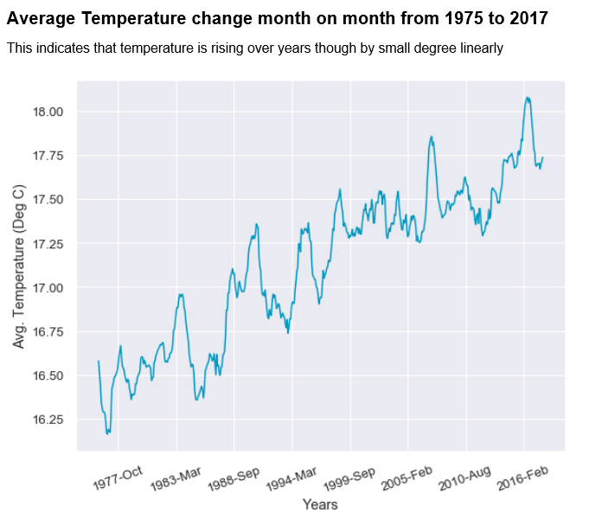
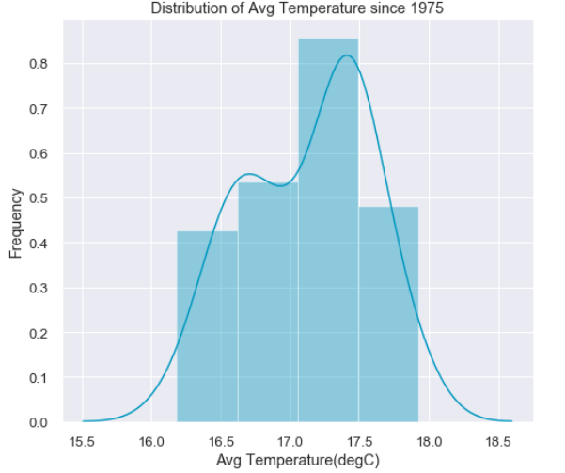
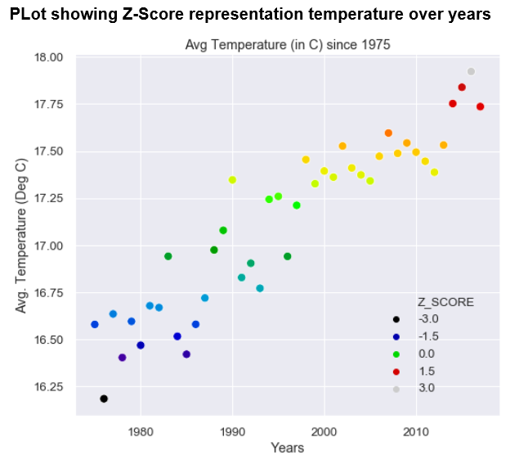
IS TEMPERATURE RISING SINCE1975

Slide 9
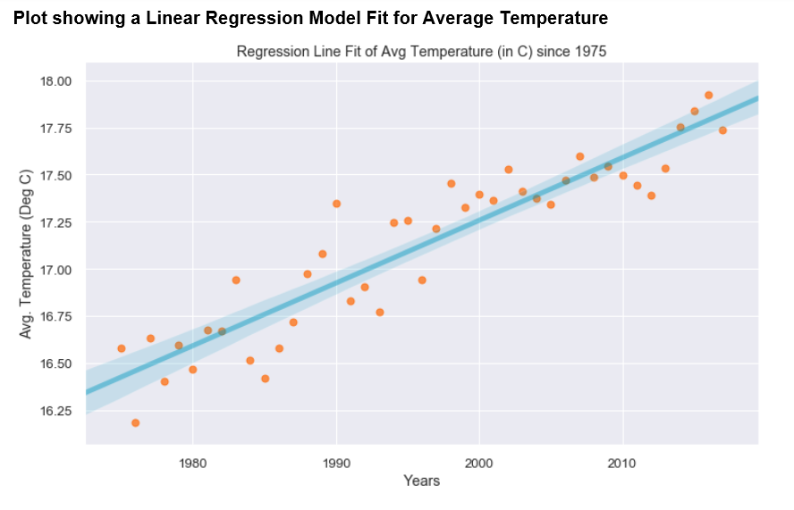
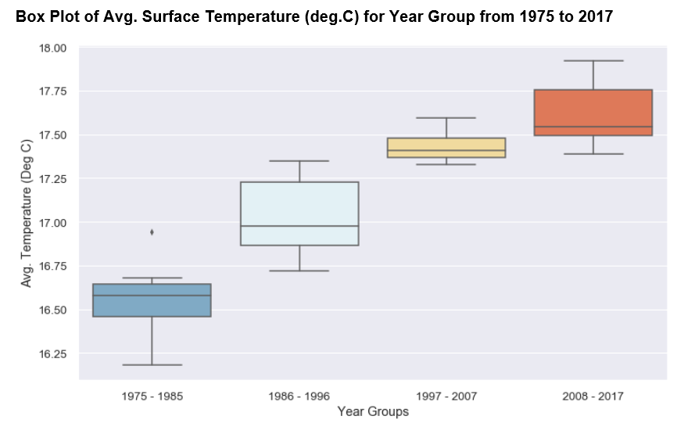
STATISTIC PROOF
ANNOVA: Analysis of 4 year groups and comparison of mean
p-Value is 3.7341400868911146e-19
P-Value shows 1.116950400152688e-16

Slide 10
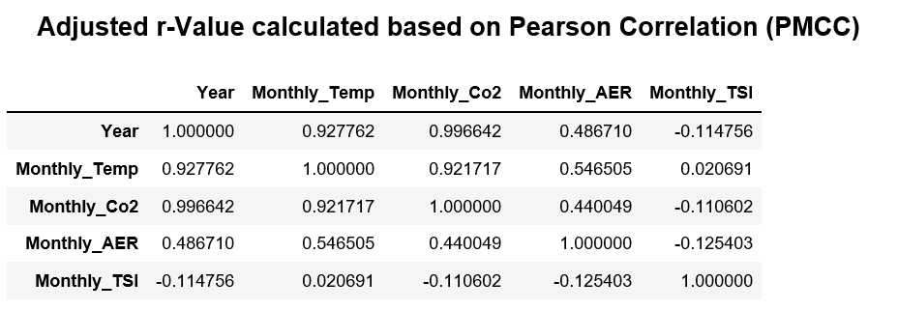
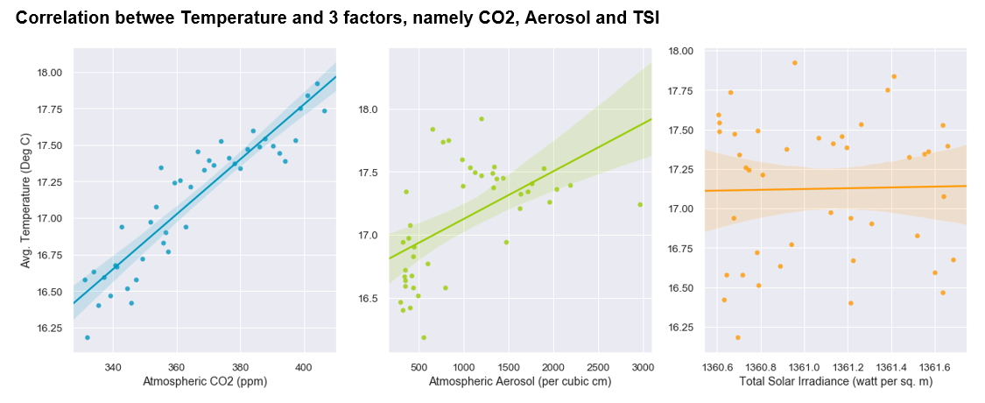
IS TEMPERATURE CORRELATED WITH CO2, TSI AND AEROSOL

Slide 11
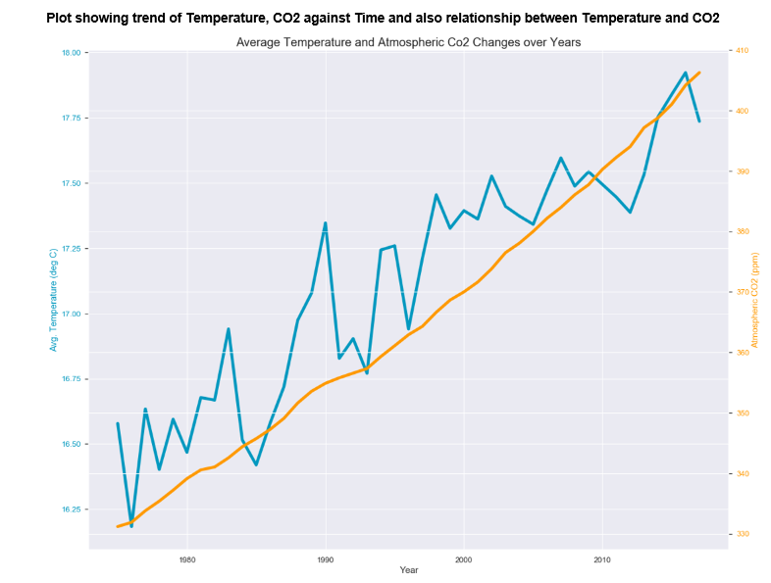
Correlation results

Slide 12



GUESS WHAT
CONCLUSION
CONCLUSION 1
CONCLUSION 2
CONCLUSION 3
Global surface air temperatures increased 1.15C degree higher to a current global average reading 17.74C degree.
Statistical Assumption of a global temperature increase is accepted for the given time period (42 years).
The Solar irradiance does not affect the rising temp.

Slide 13
CITATIONS
Dlugokencky, E.J., P.M. Lang, J.W. Mund, A.M. Crotwell, M.J. Crotwell, and K.W. Thoning (2018), Atmospheric Carbon Dioxide Dry Air Mole Fractions from the NOAA ESRL Carbon Cycle Cooperative Global Air Sampling Network, 1968-2017, Version: 2018-07-31, Path: ftp://aftp.cmdl.noaa.gov/data/trace_gases/co2/flask/surface/.
CO2
J. H. Lawrimore, M. J. Menne, B. E. Gleason, C. N. Williams, D. B. Wuertz, R. S. Vose, and J. Rennie (2011), An overview of the Global Historical Climatology Network monthly mean temperature data set, version 3, J. Geophys. Res., 116, D19121, doi:10.1029/2011JD016187. https://github.com/Madhuram-S/Thermal_Warming/blob/Steve_Newbranch/docs/ThermalWarmingStudy.pptx
TEMPERATURE
This data comes from SORCE project sponsored by NASA – Satellite Program
https://www.esrl.noaa.gov/gmd/ccgg/about/co2_measurements.html
https://co2.jpl.nasa.gov/
SOLAR IRRADIANCE
https://earthobservatory.nasa.gov/features/Aerosols
ATOMSPHERIC AEROSOLS
Additional citations are available on an addition file.
CITATIONS

Slide 14
THANK YOU!
ANY QUESTION?

